Slide 1
Deep learning software: an overview
02476 Machine Learning Operations
Nicki Skafte Detlefsen,
Postdoc
DTU Compute

Slide 2
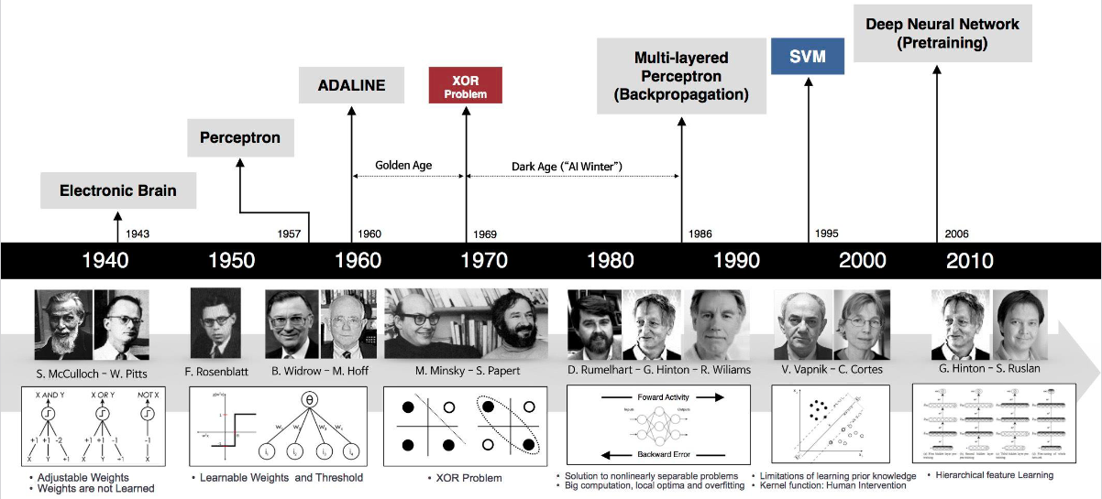
History of deep learning
Notes:
Alexey Grigoryevich Ivakhnenko 1965
Yann LeCun 1989

Slide 3

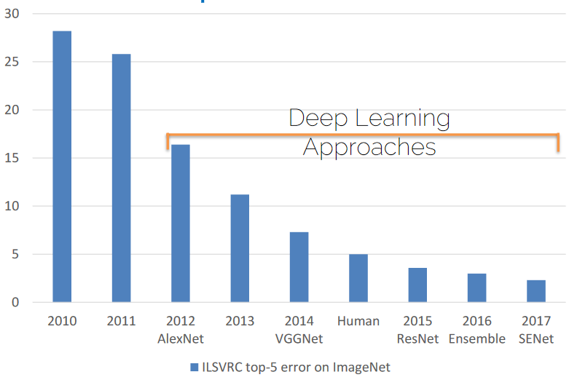
The Deep Learning Revolution

Slide 4
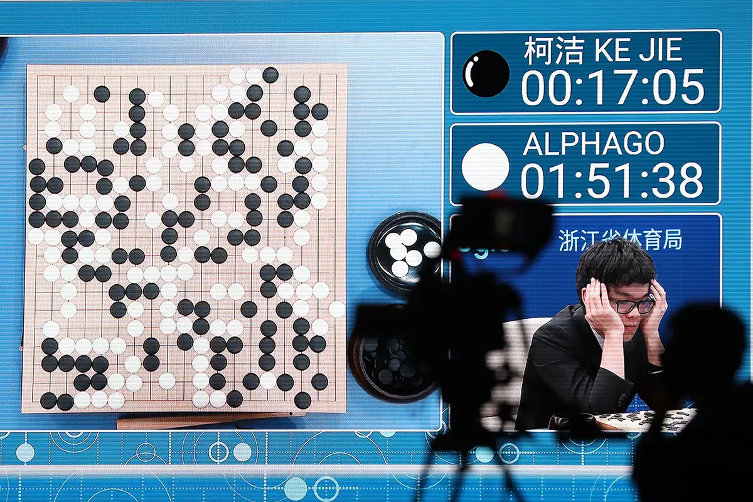
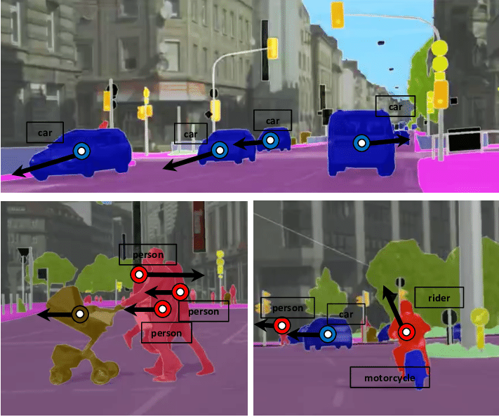
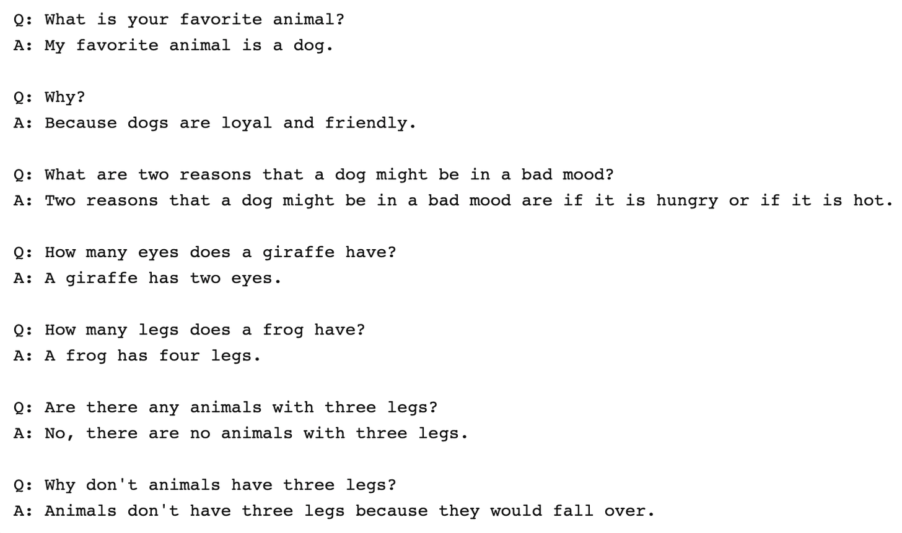
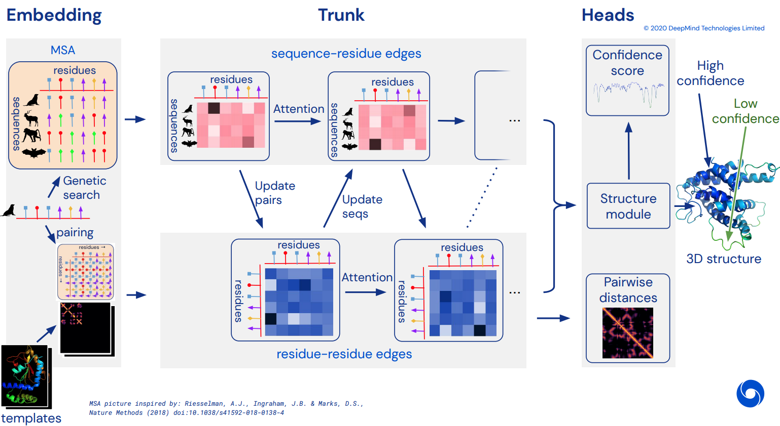
Since then...
AlphaGO:
Beating humans
Unet:
High quality semantic segmentation
GPT-3
Having conversations with humans
AlphaFold:
Solving protein engineering

Slide 5
What has changed?
Big Data
Hardware
Deepness
Hype
Software
Models can generalize
Models are trainable
Models are complex
Attacts more people
Models are easy to code
Commonly agreed on
Not talked about

Slide 6
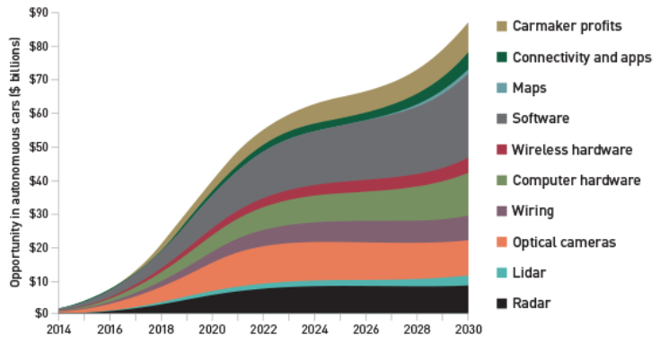
Why you should jump the wagon
“… the deep learning market is expected to be worth USD 1,722.9 Million by 2022”

Slide 7


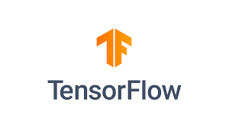

The DL software landscape
No point in discussion who is best. The (biased) facts are:
Tensorflow are too a large extend used in production
Pytorch is used in research

Slide 8
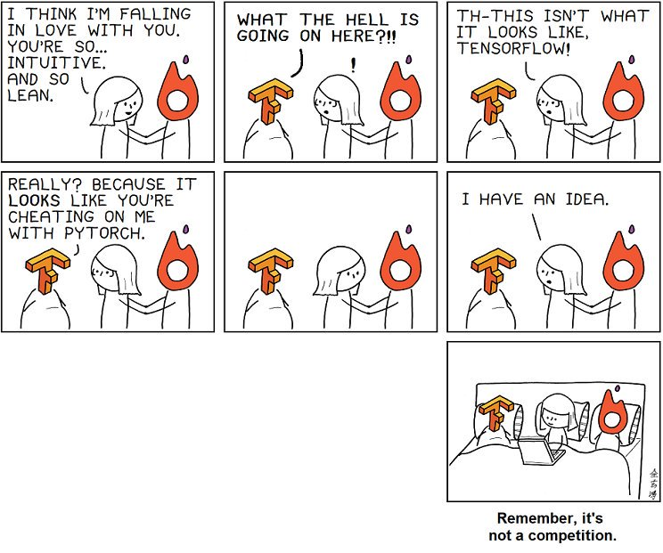
If you have the time, I recommend learning both

Slide 9
How to make a modern deep learning framework
3 key elements
Tensors
Hardware acceleration
Automatic differentation
Abstraction to higher order data
Faster computations
Ease of use

Slide 10
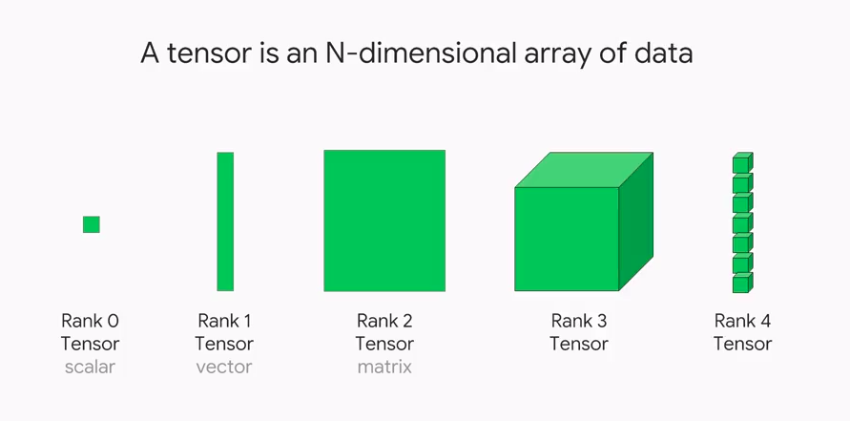
How to make a modern deep learning framework
3 key elements
Tensors
Hardware acceleration
Automatic differentation
Abstraction to higher order data
Faster computations
Ease of use

Slide 11
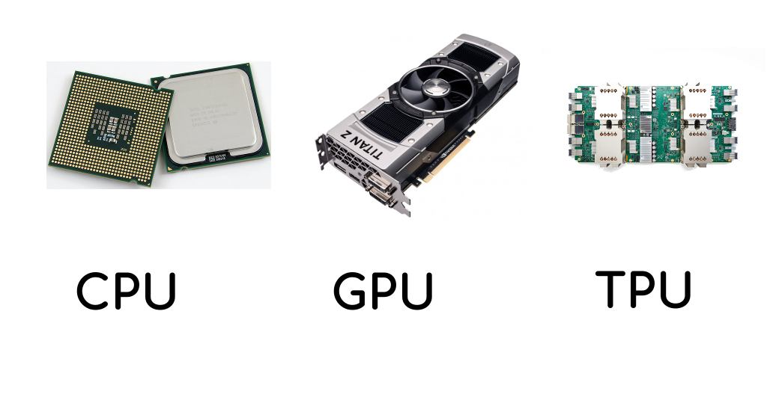
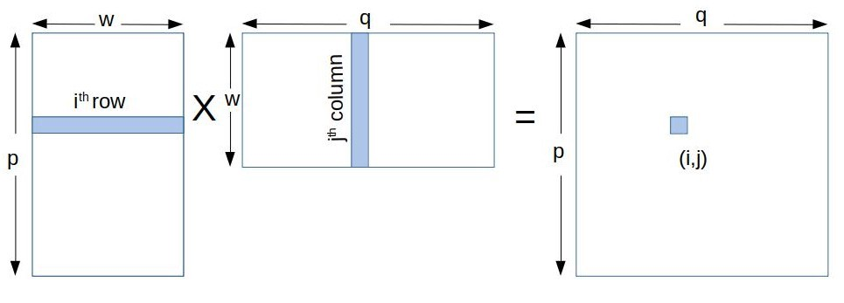
How to make a modern deep learning framework
3 key elements
Hardware acceleration
Faster computations

Slide 12
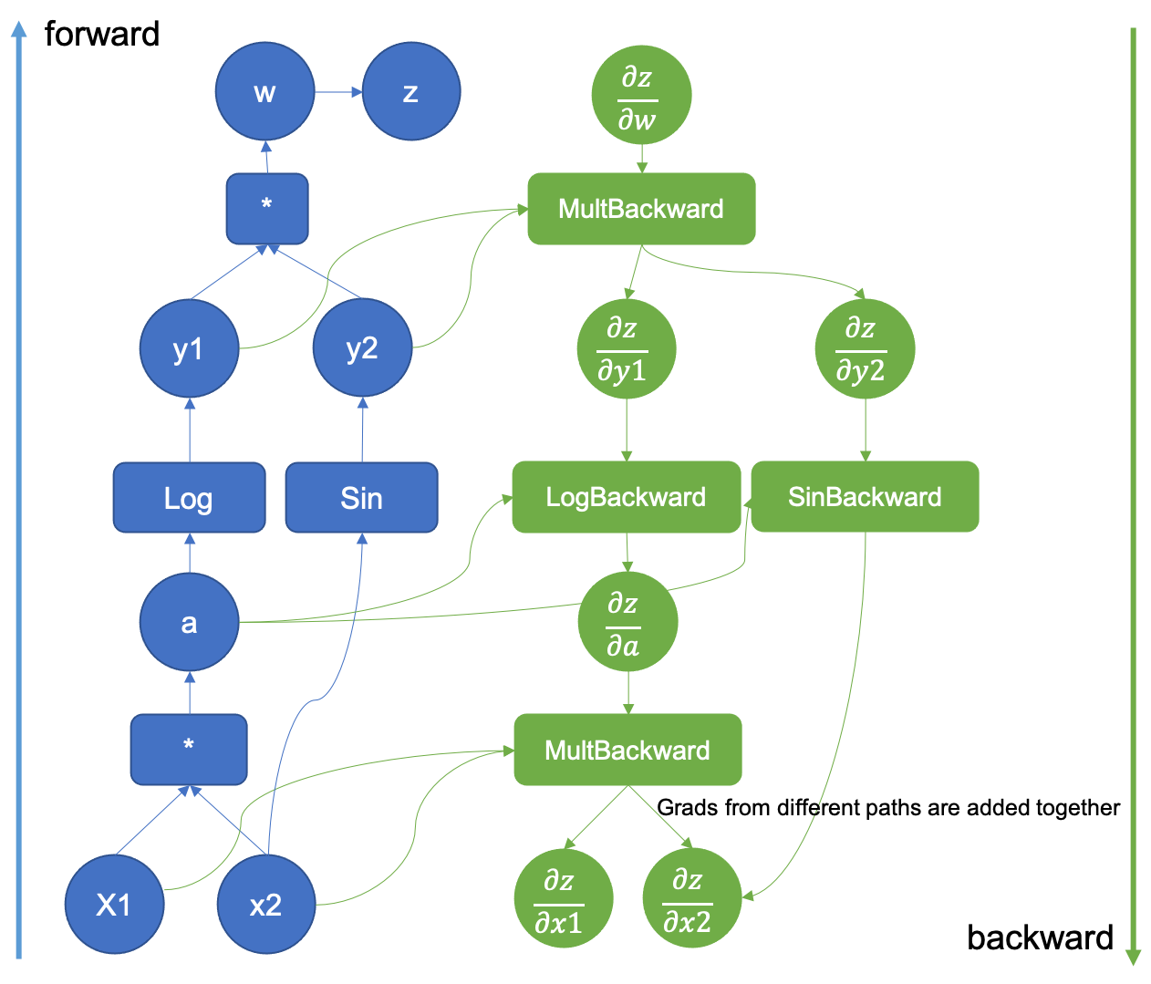
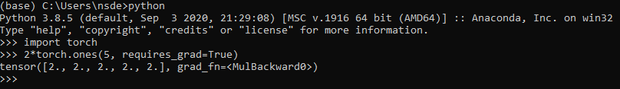
How to make a modern deep learning framework
3 key elements
Automatic differentation
Ease of use

Slide 13
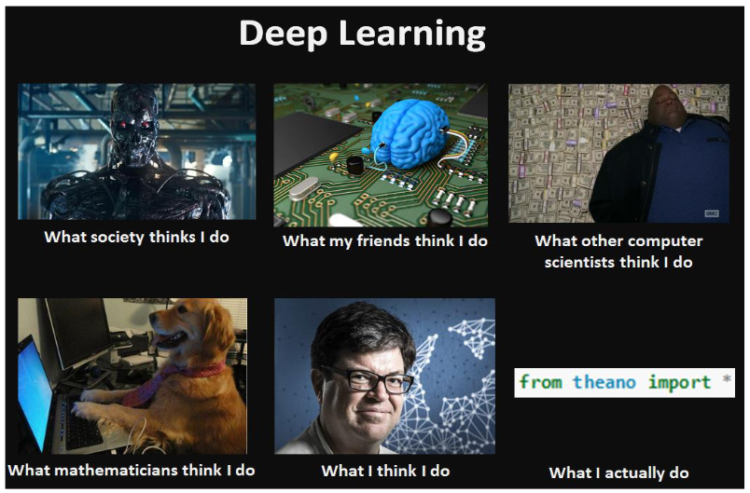
Meme of the day
https://skaftenicki.github.io/dtu_mlops/s1_getting_started/S1.html

